Slide 1
UNIT-2
Introduction to HTML
102044505
Web Development

Slide 2
What is HTML?
HTML, otherwise known as HyperText Markup Language, is the language used to create Web pages
Using HTML, you can create a Web page with text, graphics, sound, and video

Slide 3
Introduction
HTML is the standard markup language for creating Web pages.
HTML stands for Hyper Text Markup Language
HTML describes the structure of a Web page
HTML consists of a series of elements
HTML elements tell the browser how to display the content
HTML elements are represented by tags
HTML tags label pieces of content such as "heading", "paragraph", "table", and so on
Browsers do not display the HTML tags, but use them to render the content of the page

Slide 4
example
The <!DOCTYPE html> declaration defines this document to be HTML5
The <html> element is the root element of an HTML page
The <head> element contains meta information about the document
The <title> element specifies a title for the document
The <body> element contains the visible page content
The <h1> element defines a large heading
The <p> element defines a paragraph
<!DOCTYPE html>
<html>
<head>
<title>Page Title</title>
</head>
<body>
<h1>My First Heading</h1>
<p>My first paragraph.</p>
</body>
</html>

Slide 5
The <!DOCTYPE> Declaration
The <!DOCTYPE> declaration represents the document type, and helps browsers to display web pages correctly.
It must only appear once, at the top of the page (before any HTML tags).
The <!DOCTYPE> declaration is not case sensitive.
The <!DOCTYPE> declaration for HTML5 is:
<!DOCTYPE html>

Slide 6
Html Tags
The essence of HTML programming is tags
A tag is a keyword enclosed by angle brackets ( Example: <I> )
HTML tags normally come in pairs like <p> and </p>
The first tag in a pair is the start tag, the second tag is the end tag
The end tag is written like the start tag, but with a forward slash inserted before the tag name
<tagname> content goes here...</tagname>

Slide 7
More Tags...
The opening and closing tags use the same command except the closing tag contains and additional forward slash /
For example, the expression
<B> Warning </B>
would cause the word ‘Warning’ to appear in bold face on a Web page

Slide 8
Nested Tags
Whenever you have HTML tags within other HTML tags, you must close the nearest tag first
Example:
  <H1> <I> The Nation </I> </H1>

Slide 9
Structure of a Web Page
All Web pages share a common structure
All Web pages should contain a pair of <HTML>, <HEAD>, <TITLE>, and <BODY> tags
<HTML>
<HEAD>
<TITLE> Example </TITLE>
</HEAD>
<BODY>
This is where you would include the text and images on your Web page.
</BODY>
</HTML>

Slide 10
HTML Attributes
All HTML elements can have attributes
Attributes provide additional information about an element
Attributes are always specified in the start tag
Attributes usually come in name/value pairs like: name="value"
For Example:
<a href="https://www.w3schools.com">This is a link</a>
<img src="img_girl.jpg" width="500" height="600">

Slide 11
The <TITLE> Tag
Choose the title of your Web page carefully; The title of a Web page determines its ranking in certain search engines
The title will also appear on Favorite lists, History lists, and Bookmark lists to identify your page

Slide 12
Text Formatting
Manipulating text in HTML can be tricky; Oftentimes, what you see is NOT what you get
For instance, special HTML tags are needed to create paragraphs, move to the next line, and create headings
The formatting tags indicate how text can appear in HTML.
These tags can make text bold, italic, underlined, superscripted, subscripted and more.

Slide 13
Text Formatting Tags
<B> Bold Face </B>
<I> Italics </I>
<U> Underline </U>
<P> New Paragraph </P>
<BR> Next Line

Slide 14
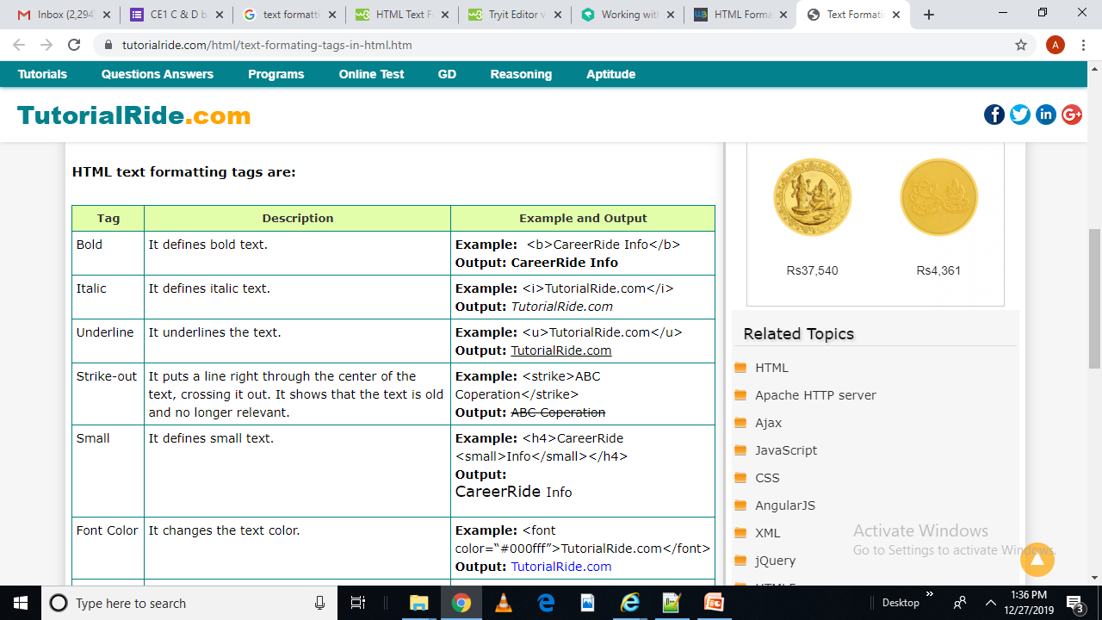


Slide 15
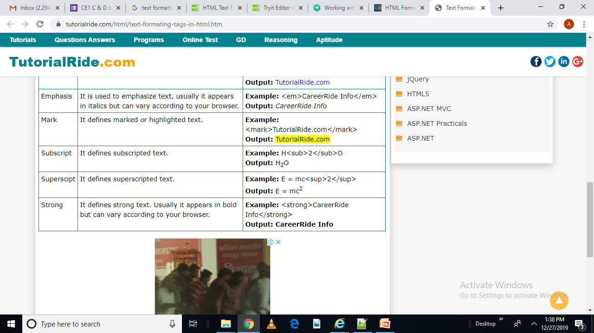

Slide 16
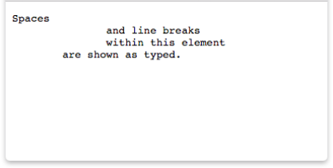
The <pre> Tag
The <pre> tag is used to define preformatted text.
The browsers render the enclosed text with white spaces and line breaks.
Example:
<pre>Spaces
and line breaks
within this element
are shown as typed. </pre>

Slide 17
Changing the Font
The expression
<FONT FACE = “fontname”> … </FONT>
can be used to change the font of the enclosed text
To change the size of text use the expression
<FONT SIZE=n> …. </FONT>
where n is a number between 1 and 7

Slide 18
Changing the Font
To change the color, use
<FONT COLOR=“red”>…. </FONT>;
The color can also be defined using hexadecimal representation ( Example: #ffffff )
These attributes can be combined to change the font, size, and color of the text all at once; For example,
<FONT SIZE=4 FACE=“Courier” COLOR=“red”> …. </FONT>

Slide 19
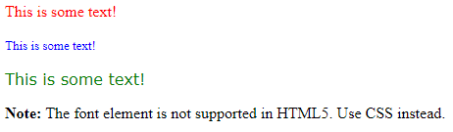
<font size="3" color="red">This is some text!</font>
<font size="2" color="blue">This is some text!</font>
<font face="verdana" color="green">This is some text!</font>
Output:

Slide 20
Headings
Web pages are typically organized into sections with headings; To create a heading use the expression <Hn>….</Hn>
where n is a number between 1 and 6
In this case, the 1 corresponds to the largest size heading while the 6 corresponds to the smallest size

Slide 21
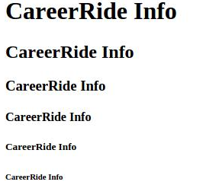
<!DOCTYPE html>
<html>
<head>
<title>Example of Heading Tag</title>
</head>
<body>
<h1>CareerRide Info</h1>
<h2>CareerRide Info</h2>
<h3>CareerRide Info</h3>
<h4>CareerRide Info</h4>
<h5>CareerRide Info</h5>
<h6>CareerRide Info</h6>
</body>
</html>
Output:

Slide 22
Center Tag
Center tag is used to place the content in the center of a web page.
<center>
<p>This is a paragraph.</p>
</center>

Slide 23
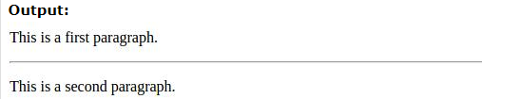
Horizontal line (<hr> tag)
This is used to draw a horizontal line on a web page.
The <hr> tag has no end tag.
<body>
<p>This is a first paragraph.</p>
<hr />
<p>This is a second paragraph.</p>
</body>

Slide 24
Aligning Text
The ALIGN attribute can be inserted in the <P> and <Hn> tags to right justify, center, or left justify the text
For example,
<H1 ALIGN=CENTER> The New York Times </H1>
would create a centered heading of the largest size

Slide 25
Comment Statements
Comment statements are notes in the HTML code that explain the important features of the code
The comments do not appear on the Web page itself but are a useful reference to the author of the page and other programmers
To create a comment statement use the <!-- …. --> tags

Slide 26
Blink Tag
It is possible to make text blink using the <BLINK> … </BLINK> tag
However, it is best to use this feature at most sparingly or not at all; What seems like a good idea to a Web designer can become very annoying to a Web user
The <BLINK> tag is not supported by Internet Explorer

Slide 27
BODY Tag
The <body> element contains all the contents of an HTML document, such as text, hyperlinks, images, tables, lists, etc.
Attributes
background: It contains the URL of background image. It is used to set the background image.
bgcolor: It is used to specify the background color of document.
alink: It is used to specify the color of active link.
link: Specifies the color of unvisited links in a document
text: It specify the color of text in a document.
vlink: It specify the color of visited links.

Slide 28
Example
<!DOCTYPE html>
<html>
<body background="w3s.png“ >
<h1>Hello world!</h1>
<p>Visit </p>
<p>The background attribute is not supported HTML5. Use CSS instead.</p>
</body>
</html>
Syntax for other attribute:
<body text="green"> <body link="blue">
<body bgcolor=“red"> <body bgcolor="#000000">
<body bgcolor="rgb(0,0,0)“>

Slide 29
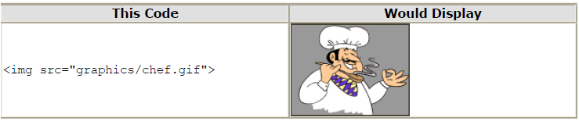
Image Tag
Images can improve the design and the appearance of a web page.
To display an image on a page, you need to use the src attribute.
Src stands for "source".
The value of the src attribute is the URL of the image you want to display on your page. The syntax of defining an image:

Slide 30
Alternate Text
The alt attribute is used to define an alternate text for an image.
The alt attribute provides an alternate text for an image, if the user for some reason cannot view it.
The value of the alt attribute is User-defined text:
<img src="graphics/chef.gif" alt="Smiling Happy Chef ">

Slide 31
Image Dimensions
Width and Height
<img src="img_girl.jpg" alt="Girl in ajacket" width="500" height="600">

Slide 32
Links/ Anchor Tag
HTML uses the <a> anchor tag to create a link to another document or web page.
There are different types of links:
Absolute Link:
These are the links which are fully qualified as a URL, they are present on the Web already. Ex. https://www.google.co.in
Relative Link:
These are the links which are related to our own document and these types of links are the part of our website.
Internal Link:
It is used to navigate from one portion of our webpage to other portion of our webpage.

Slide 33
Attributes for the Anchor Tag:
href:
It stands for hyperlink reference, it is used to add link to our Webpage.
target:
It is used in case of links, it helps if we want to open our link in a new tab or In the same tab in which we are working.
download:
It is a attribute which is used to download a file which is attached in our webpage just by clicking on it. It works only when href attribute is also used.

Slide 34
HTML Links - The target Attribute
The target attribute specifies where to open the linked document.
The target attribute can have one of the following values:
_blank - Opens the linked document in a new window/ tab
_self - Opens the linked document in the same window/tab as it was clicked (this is default)
_parent - Opens the linked document in the parent frame
_top - Opens the linked document in the full body of the window
framename - Opens the linked document in a named frame

Slide 35
Example: Links
To create a link to CNN, I would type:
  <A HREF=“http://www.cnn.com”>CNN</A>
To create a link to MIT, I would type:
  <A HREF=“http://www.mit.edu”>MIT</A>

Slide 36
Changing the Color of Links
The LINK, VLINK, and ALINK attributes can be inserted in the <BODY> tag to define the color of a link
  LINK defines the color of links that have not been visited
  VLINK defines the color of links that have already been visited
  ALINK defines the color of a link when a user clicks on it

Slide 37
Using Links to Send Email
To create a link to an email address, type <A HREF=“mailto:email_address”> Label</A>
For example, to create a link to send email to myself, I would type: <A HREF=“mailto: ktdunn@mit.edu”>email Katie Dunn</A>

Slide 38
Anchors
Anchors enable a user to jump to a specific place on a Web site
Two steps are necessary to create an anchor. First you must create the anchor itself. Then you must create a link to the anchor from another point in the document.

Slide 39
Anchors
To create the anchor itself, type <A NAME=“anchor name”>label</A> at the point in the Web page where you want the user to jump to
To create the link, type <A HREF=“#anchor name”>label</A> at the point in the text where you want the link to appear

Slide 40
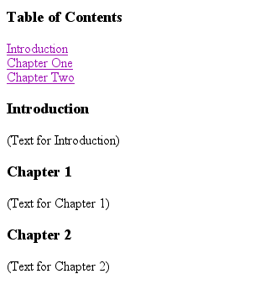
Example: Anchor
<A HREF="#chap2">Chapter Two</A><BR>
Link
<A NAME="chap2">Chapter 2 </A>
Anchor

Slide 41

Ordered Lists
Ordered lists are a list of numbered items.
To create an ordered list, type:
  <OL>
    <LI> This is step one.
    <LI> This is step two.
    <LI> This is step three.
  </OL>
Here’s how it would look on the Web:

Slide 42
More Ordered Lists….
The TYPE=x attribute allows you to change the the kind of symbol that appears in the list.
  A is for capital letters
  a is for lowercase letters
  I is for capital roman numerals
  i is for lowercase roman numerals

Slide 43

Unordered Lists
An unordered list is a list of bulleted items
To create an unordered list, type:
  <UL>
    <LI> First item in list
    <LI> Second item in list
    <LI> Third item in list
  </UL>
Here’s how it would look on the Web:

Slide 44
More Unordered Lists...
The TYPE=shape attribute allows you to change the type of bullet that appears
  circle corresponds to an empty round bullet
  square corresponds to a square bullet
  disc corresponds to a solid round bullet; this is the default value

Slide 45
Forms
What are forms?
  An HTML form is an area of the document that allows users to enter information into fields.
  A form may be used to collect personal information, opinions in polls, user preferences and other kinds of information.

Slide 46
Forms
There are two basic components of a Web form: the shell, the part that the user fills out, and the script which processes the information
HTML tags are used to create the form shell. Using HTML you can create text boxes, radio buttons, checkboxes, drop-down menus, and more...

Slide 47
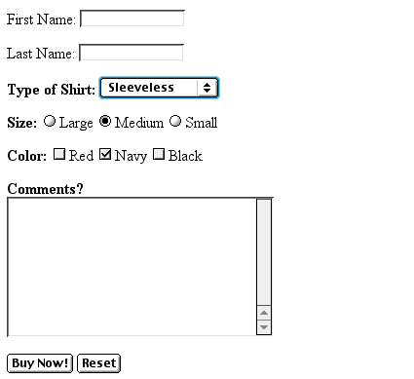
Example: Form
Text Box
Drop-down Menu
Radio Buttons
Checkboxes
Text Area
Reset Button
Submit Button

Slide 48
The Form Shell
A form shell has three important parts:
  the <FORM> tag, which includes the address of the script which will process the form
  the form elements, like text boxes and radio buttons
  the submit button which triggers the script to send the entered information to the server

Slide 49
Creating the Shell
To create a form shell, type <FORM METHOD=POST ACTION=“script_url”> where “script_url” is the address of the script
Create the form elements
End with a closing </FORM> tag

Slide 50
Creating Text Boxes
To create a text box, type <INPUT TYPE=“text” NAME=“name” VALUE=“value” SIZE=n MAXLENGTH=n>
The NAME, VALUE, SIZE, and MAXLENGTH attributes are optional

Slide 51
Text Box Attributes
The NAME attribute is used to identify the text box to the processing script
The VALUE attribute is used to specify the text that will initially appear in the text box
The SIZE attribute is used to define the size of the box in characters
The MAXLENGTH attribute is used to define the maximum number of characters that can be typed in the box

Slide 52

Example: Text Box
First Name: <INPUT TYPE="text" NAME="FirstName" VALUE="First Name" SIZE=20>
<BR><BR>
Last Name: <INPUT TYPE="text" NAME="LastName" VALUE="Last Name" SIZE=20>
<BR><BR>
Here’s how it would look on the Web:

Slide 53
Creating Larger Text Areas
To create larger text areas, type <TEXTAREA NAME=“name” ROWS=n1 COLS=n2 WRAP> Default Text </TEXTAREA>, where n1 is the height of the text box in rows and n2 is the width of the text box in characters
The WRAP attribute causes the cursor to move automatically to the next line as the user types

Slide 54
Example: Text Area
<B>Comments?</B>
<BR>
<TEXTAREA NAME="Comments" ROWS=10 COLS=50 WRAP>
</TEXTAREA>

Slide 55
Creating Radio Buttons
To create a radio button, type <INPUT TYPE=“radio” NAME=“name” VALUE=“data”>Label, where “data” is the text that will be sent to the server if the button is checked and “Label” is the text that identifies the button to the user

Slide 56
Example: Radio Buttons
<B> Size: </B>
<INPUT TYPE="radio" NAME="Size"
VALUE="Large">Large
<INPUT TYPE="radio" NAME="Size"
VALUE="Medium">Medium
<INPUT TYPE="radio" NAME="Size"
VALUE="Small">Small

Slide 57
Creating Checkboxes
To create a checkbox, type <INPUT TYPE=“checkbox” NAME=“name” VALUE=“value”>Label
If you give a group of radio buttons or checkboxes the same name, the user will only be able to select one button or box at a time

Slide 58
Example: Checkboxes
<B> Color: </B>
<INPUT TYPE="checkbox" NAME="Color" VALUE="Red">Red
<INPUT TYPE="checkbox" NAME="Color"
VALUE="Navy">Navy
<INPUT TYPE="checkbox" NAME="Color"
VALUE="Black">Black

Slide 59
Creating Drop-down Menus
To create a drop-down menu, type <SELECT NAME=“name” SIZE=n MULTIPLE>
Then type <OPTION VALUE= “value”>Label
In this case the SIZE attribute specifies the height of the menu in lines and MULTIPLE allows users to select more than one menu option

Slide 60
Example: Drop-down Menu
<B>WHICH IS FAVOURITE FRUIT:</B>
<SELECT>
<OPTION VALUE="MANGOES">MANGOES
<OPTION VALUE="PAPAYA">PAPAYA
<OPTION VALUE="GUAVA">GUAVA
<OPTION VALUE="BANANA"> BANANA
<OPTION VALUE="PINEAPPLE">PINEAPPLE
</SELECT>

Slide 61
Creating a Submit Button
To create a submit button, type <INPUT TYPE=“submit”>
If you would like the button to say something other than submit, use the VALUE attribute
For example, <INPUT TYPE=“submit” VALUE=“Buy Now!”> would create a button that says “Buy Now!”

Slide 62
Creating a Reset Button
To create a reset button, type <INPUT TYPE=“reset”>
The VALUE attribute can be used in the same way to change the text that appears on the button

Slide 63
Tables
Tables can be used to display rows and columns of data, create multi-column text, captions for images, and sidebars
The <TABLE> tag is used to create a table; the <TR> tag defines the beginning of a row while the <TD> tag defines the beginning of a cell

Slide 64
Adding a Border
The BORDER=n attribute allows you to add a border n pixels thick around the table
To make a solid border color, use the BORDERCOLOR=“color” attribute
To make a shaded colored border, use BODERCOLORDARK=“color” and BORDERCOLORLIGHT=“color”

Slide 65

Creating Simple Table
<TABLE BORDER=10>
<TR>
<TD>One</TD>
<TD>Two</TD>
</TR>
<TR>
<TD>Three</TD>
<TD>Four</TD>
</TR>
</TABLE>
Here’s how it would look on the Web:

Slide 66
Adjusting the Width
When a Web browser displays a table, it often adds extra space. To eliminate this space use the WIDTH =n attribute in the <TABLE> and <TD> tags
Keep in mind - a cell cannot be smaller than its contents, and if you make a table wider than the browser window, users will not be able to see parts of it.

Slide 67
Centering a Table
There are two ways to center a table
  Type <TABLE ALIGN=CENTER>
  Enclose the <TABLE> tags in opening and closing <CENTER> tags

Slide 68
Wrapping Text around a Table
It is possible to wrap text around a table. This technique is often used to keep images and captions together within an article.
To wrap text around a table, type <TABLE ALIGN = LEFT> to align the table to the left while the text flows to the right.
Create the table using the <TR>, <TD>, and </TABLE> tags as you normally would

Slide 69
Adding Space around a Table
To add space around a table, use the HSPACE=n and VSPACE=n attributes in the <TABLE> tag
Example:
  <TABLE HSPACE=20 VSPACE=20>

Slide 70
Spanning Cells Across Columns
It is often necessary to span one cell across many columns. For example, you would use this technique to span a headline across the columns of a newspaper article.
To span a cell across many columns, type <TD COLSPAN=n>, where n is the number of columns to be spanned

Slide 71
Spanning Cells Across Rows
To span a cell across many rows, type <TD ROWSPAN=n>, where n is the number of rows

Slide 72
Aligning Cell Content
By default, a cell’s content are aligned horizontally to the left and and vertically in the middle.
Use VALIGN=direction to change the vertical alignment, where “direction” is top, middle, bottom, or baseline _x0008_
Use ALIGN=direction to change the horizontal alignment where “direction” is left, center, or right

Slide 73
Controlling Cell Spacing
Cell spacing is the space between cells while cell padding is the space around the contents of a cell
To control both types of spacing, use the CELLSPACING =n and CELLPADDING=n attributes in the <TABLE> tag

Slide 74
Nesting Tables
Create the inner table
Create the outer table and determine which cell of the outer table will hold the inner table
Test both tables separately to make sure they work
Copy the inner table into the cell of the outer table
Don’t nest too many tables. If you find yourself doing that, find an easier way to lay out your Web page

Slide 75
Changing a Cell’s Color
To change a cell’s color, add the BGCOLOR=“color” attribute to the <TD> tag
Example:
  <TD BGCOLOR=“blue”>

Slide 76
Dividing Your Table into Column Groups
You can divide your table into two kinds of column groups: structural and non-structural.
Structural column groups control where dividing lines are drawn; Non-structural groups do not
Both let you format an entire column of cells at once

Slide 77
Column Groups
To create structural column groups, type <COLGROUP SPAN=n> after the <TABLE> tag, where n is the number of columns in the group
To create non-structural column groups, type <COL SPAN=n>, where n is the number of columns in the group

Slide 78
Dividing Table into Horizontal Sections
You can also create a horizontal section consisting of one or more rows. This allows you to format the rows all at once
To create a horizontal section, type <THEAD>, <TBODY>, or <TFOOT> before the first <TR> tag of the section
Netscape does not support these tags

Slide 79
Controlling Line Breaks
Unless you specify otherwise a browser will divide the lines in a cell as it sees fit.
The NOWRAP attribute placed within the <TD> tag forces the browser to keep all the text in a cell on one line
Example:
  <TD NOWRAP>Washington, D.C.

Slide 80
Parting Words….
If you can imagine a way to lay out your page, chances are it is possible using HTML
When in doubt, use an HTML reference

